Slide 1

ONLINE RETAIL – UCI SALES ANALYSIS
ANALYSIS DASHBOARD USING POWER BI

Slide 2
Objective
The Online Retail UCI Analysis aims to provide key insights into sales trends, customer behavior, and profitability for an online retail business.
The analysis is designed to help businesses make data-driven decisions by identifying patterns in orders, sales performance, and country-wise distribution.
Helps in forecasting demand and managing inventory efficiently.
Identifies the most profitable countries and customer segments.
Aids in setting pricing strategies to maximize revenue and minimize losses.
Improves decision-making with a data-driven approach to sales and marketing.

Slide 3
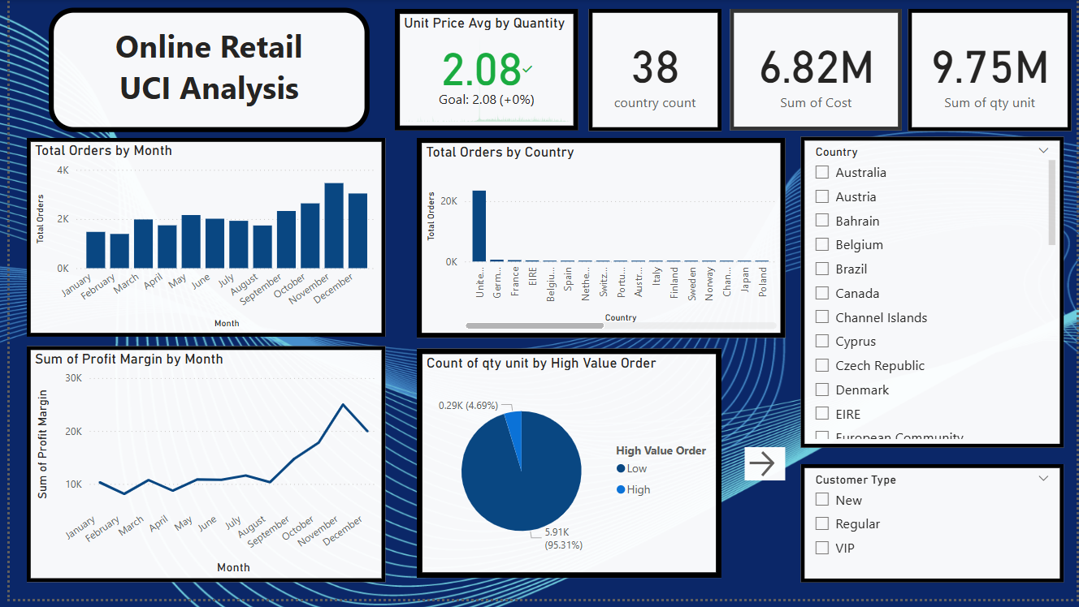

Slide 4
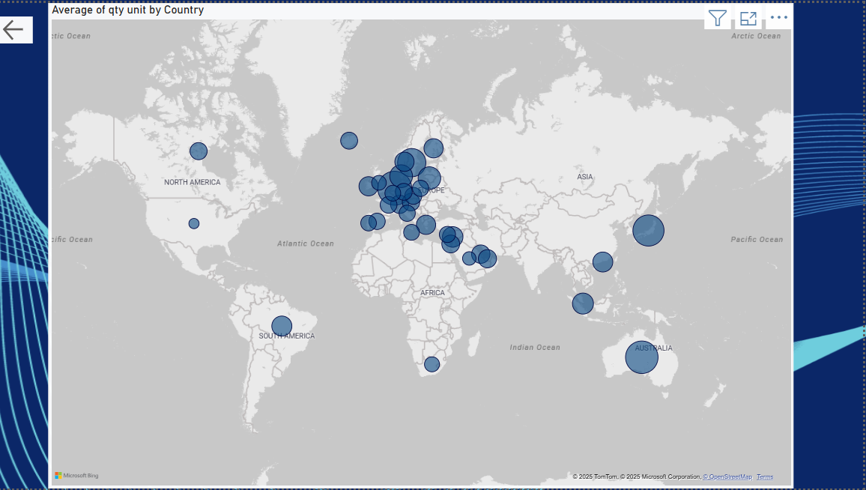

Slide 5
CONCLUSION
PERFORMED ANALYSIS
Sales Trends
Market & Customer Insights
Revenue & Cost Optimization
Data-driven decision-making can enhance marketing and sales strategies.
Identifying peak sales periods aids in inventory planning.
Understanding customer segmentation helps in personalized engagement.

